Slide 1
Chapter 3
Time Value of Money

Slide 2
The Time Value of Money
The Interest Rate
Simple Interest
Compound Interest
Amortizing a Loan

Slide 3
The Interest Rate
Which would you prefer -- $10,000 today or $10,000 in 5 years?
Obviously, $10,000 today.
You already recognize that there is TIME VALUE TO MONEY!!

Slide 4
Why TIME?
Why is TIME such an important element in your decision?
TIME allows you the opportunity to postpone consumption and earn INTEREST.

Slide 5
Types of Interest
Simple Interest
  Interest paid (earned) on only the original amount, or principal borrowed (lent).
Compound Interest
  Interest paid (earned) on any previous interest earned, as well as on the principal borrowed (lent).

Slide 6
Simple Interest Formula
Formula SI = P₀(i)(n)
  SI: Simple Interest
  P₀: Deposit today (t=0)
  i: Interest Rate per Period
  n: Number of Time Periods

Slide 7
Simple Interest Example
Assume that you deposit $1,000 in an account earning 7% simple interest for 2 years. What is the accumulated interest at the end of the 2nd year?
SI = P₀(i)(n) = $1,000(.07)(2) = $140

Slide 8
Simple Interest (FV)
What is the Future Value (FV) of the deposit?
FV = P₀ + SI = $1,000 + $140 = $1,140
Future Value is the value at some future time of a present amount of money, or a series of payments, evaluated at a given interest rate.

Slide 9
Simple Interest (PV)
What is the Present Value (PV) of the previous problem?
The Present Value is simply the $1,000 you originally deposited. That is the value today!
Present Value is the current value of a future amount of money, or a series of payments, evaluated at a given interest rate.

Slide 10
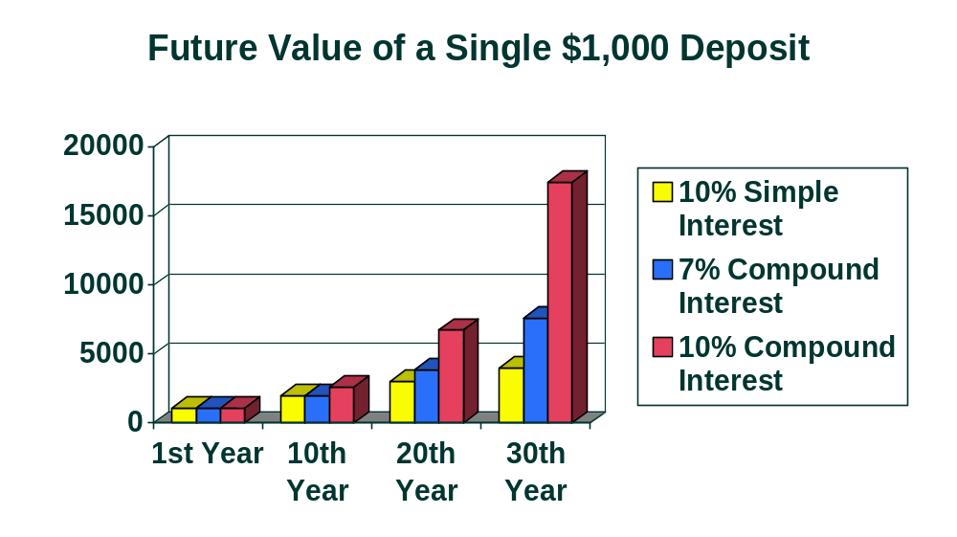
Why Compound Interest?
Future Value (U.S. Dollars)

Slide 11
Future Value
Single Deposit (Graphic)
Assume that you deposit $1,000 at a compound interest rate of 7% for 2 years.
0 1 2
7%
$1,000
FV₂

Slide 12
Future Value
Single Deposit (Formula)
FV₁ = P₀ (1+i)¹ = $1,000 (1.07) = $1,070
Compound Interest
You earned $70 interest on your $1,000 deposit over the first year.
This is the same amount of interest you would earn under simple interest.

Slide 13
Future Value
Single Deposit (Formula)
FV₁ = P₀ (1+i)¹ = $1,000 (1.07) = $1,070
FV₂ = FV₁ (1+i)¹ = P₀ (1+i)(1+i) = $1,000(1.07)(1.07) = P₀ (1+i)² = $1,000(1.07)² = $1,144.90
You earned an EXTRA $4.90 in Year 2 with compound over simple interest.

Slide 14
General Future Value Formula
FV₁ = P₀(1+i)¹
FV₂ = P₀(1+i)²
General Future Value Formula:
FV_{n} = P₀ (1+i)^{n}
or FV_{n} = P₀ (FVIF_{i,n}) -- See Table I
etc.

Slide 15
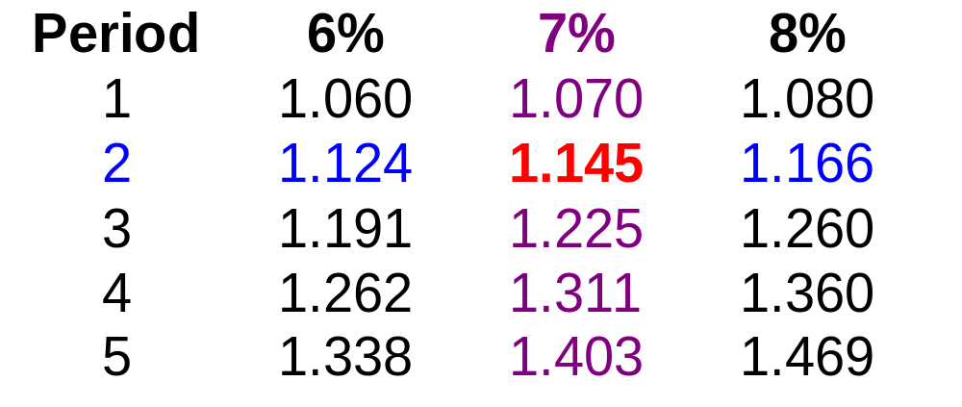
Valuation Using Table I
FVIF_{i,n} is found on Table I at the end of the book or on the card insert.

Slide 16
Using Future Value Tables
FV₂ = $1,000 (FVIF_{7%,2}) = $1,000 (1.145) = $1,145 [Due to Rounding]

Slide 17
Story Problem Example
Julie Miller wants to know how large her deposit of $10,000 today will become at a compound annual interest rate of 10% for 5 years.
0 1 2 3 4 5
10%
$10,000
FV₅

Slide 18
Story Problem Solution
Calculation based on general formula: FV_{n} = P₀ (1+i)^{n} FV₅ = $10,000 (1+ 0.10)⁵ = $16,105.10
Calculation based on Table I: FV₅ = $10,000 (FVIF_{10%, 5}) = $10,000 (1.611) = $16,110 [Due to Rounding]

Slide 19
Double Your Money!!!
Quick! How long does it take to double $5,000 at a compound rate of 12% per year (approx.)?
We will use the “Rule-of-72”.

Slide 20
The “Rule-of-72”
Quick! How long does it take to double $5,000 at a compound rate of 12% per year (approx.)?
Approx. Years to Double = 72 / i%
        72 / 12% = 6 Years
        [Actual Time is 6.12 Years]

Slide 21
Present Value Single Deposit (Graphic)
Assume that you need $1,000 in 2 years. Let’s examine the process to determine how much you need to deposit today at a discount rate of 7% compounded annually.
0 1 2
7%
$1,000
PV₀
PV₁

Slide 22
Present Value
Single Deposit (Formula)
PV₀ = FV₂ / (1+i)² = $1,000 / (1.07)² = FV₂ / (1+i)² = $873.44
0 1 2
7%
$1,000
PV₀

Slide 23
General Present Value Formula
PV₀ = FV₁ / (1+i)¹
PV₀ = FV₂ / (1+i)²
General Present Value Formula:
PV₀ = FV_{n} / (1+i)^{n}
or PV₀ = FV_{n} (PVIF_{i,n}) -- See Table II
etc.

Slide 24
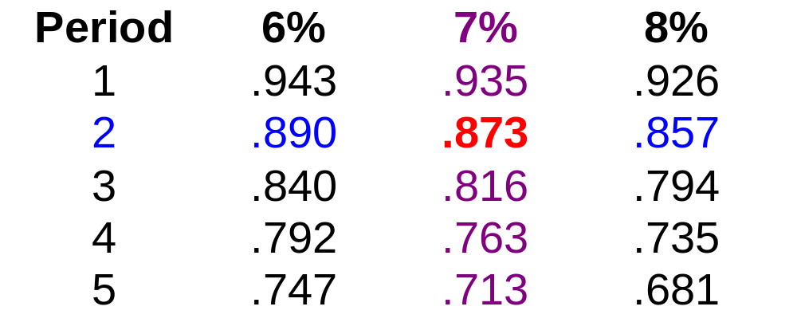
Valuation Using Table II
PVIF_{i,n} is found on Table II at the end of the book or on the card insert.

Slide 25
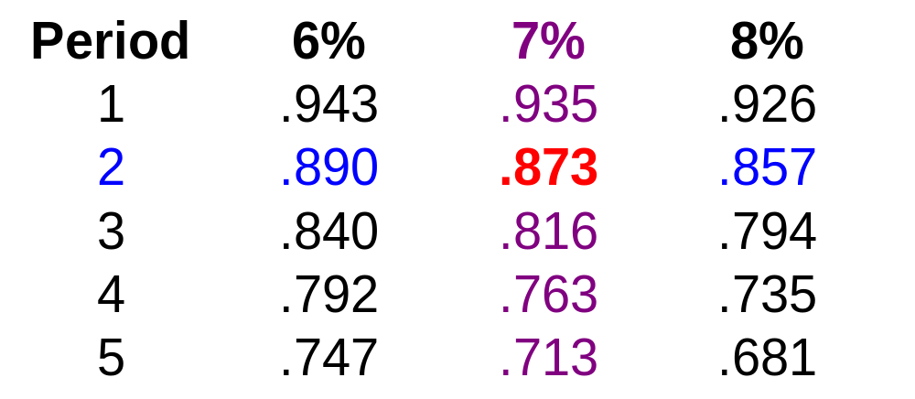
Using Present Value Tables
PV₂ = $1,000 (PVIF_{7%,2}) = $1,000 (.873) = $873 [Due to Rounding]

Slide 26
Story Problem Example
Julie Miller wants to know how large of a deposit to make so that the money will grow to $10,000 in 5 years at a discount rate of 10%.
0 1 2 3 4 5
10%
$10,000
PV₀

Slide 27
Story Problem Solution
Calculation based on general formula: PV₀ = FV_{n} / (1+i)^{n} PV₀ = $10,000 / (1+ 0.10)⁵ = $6,209.21
Calculation based on Table I: PV₀ = $10,000 (PVIF_{10%, 5}) = $10,000 (.621) = $6,210.00 [Due to Rounding]

Slide 28
Solving the PV Problem
Inputs
5 10 0 +10,000
N
I/Y
PV
PMT
FV
Compute
-6,209.21
The result indicates that a $10,000 future value that will earn 10% annually for 5 years requires a $6,209.21 deposit today (present value).

Slide 29
Types of Annuities
An Annuity represents a series of equal payments (or receipts) occurring over a specified number of equidistant periods.
Ordinary Annuity: Payments or receipts occur at the end of each period.
Annuity Due: Payments or receipts occur at the beginning of each period.

Slide 30
Examples of Annuities
Student Loan Payments
Car Loan Payments
Insurance Premiums
Mortgage Payments
Retirement Savings

Slide 31
Parts of an Annuity
(Ordinary Annuity)
End of
Period 1
End of
Period 2
End of
Period 3
0 1 2 3
$100 $100 $100
Today
Equal Cash Flows
Each 1 Period Apart

Slide 32
Parts of an Annuity
(Annuity Due)
Beginning of
Period 1
Beginning of
Period 2
Beginning of
Period 3
0 1 2 3
$100 $100 $100
Today
Equal Cash Flows
Each 1 Period Apart

Slide 33
Overview of an
Ordinary Annuity -- FVA
Cash flows occur at the end of the period
0 1 2 n n+1
i%
. . .
R R R
R = Periodic
Cash Flow
FVA_{n} = R(1+i)^{n-1} + R(1+i)^{n-2} + ... + R(1+i)¹ + R(1+i)⁰
FVA_{n}

Slide 34
Example of an
Ordinary Annuity -- FVA
Cash flows occur at the end of the period
0 1 2 3 4
7%
$1,000 $1,000 $1,000
$1,070
$1,145
FVA₃ = $1,000(1.07)² + $1,000(1.07)¹ + $1,000(1.07)⁰
= $1,145 + $1,070 + $1,000 = $3,215
$3,215 = FVA₃

Slide 35
Hint on Annuity Valuation
The future value of an ordinary annuity can be viewed as occurring at the end of the last cash flow period, whereas the future value of an annuity due can be viewed as occurring at the beginning of the last cash flow period.

Slide 36
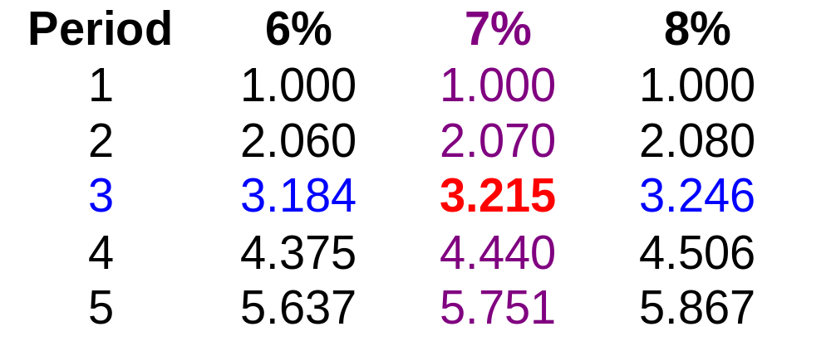
Valuation Using Table III
FVA_{n} = R (FVIFA_{i%,n}) FVA₃ = $1,000 (FVIFA_{7%,3}) = $1,000 (3.215) = $3,215

Slide 37
Overview View of an
Annuity Due -- FVAD
Cash flows occur at the beginning of the period
0 1 2 3 n-1 n
i%
. . .
R R R R R
FVAD_{n} = R(1+i)^{n} + R(1+i)^{n-1} + ... + R(1+i)² + R(1+i)¹ = FVA_{n} (1+i)
FVAD_{n}

Slide 38
Example of an
Annuity Due -- FVAD
Cash flows occur at the beginning of the period
0 1 2 3 4
7%
$1,000 $1,000 $1,000 $1,070
$1,145
$1,225
FVAD₃ = $1,000(1.07)³ + $1,000(1.07)² + $1,000(1.07)¹
= $1,225 + $1,145 + $1,070 = $3,440
$3,440 = FVAD₃

Slide 39
Valuation Using Table III
FVAD_{n} = R (FVIFA_{i%,n})(1+i)
FVAD₃ = $1,000 (FVIFA_{7%,3})(1.07) = $1,000 (3.215)(1.07) = $3,440

Slide 40
Overview of an
Ordinary Annuity -- PVA
Cash flows occur at the end of the period
0 1 2 n n+1
i%
. . .
R R R
R = Periodic
Cash Flow
PVA_{n}
PVA_{n} = R/(1+i)¹ + R/(1+i)²
+ ... + R/(1+i)^{n}

Slide 41
Example of an
Ordinary Annuity -- PVA
Cash flows occur at the end of the period
0 1 2 3 4
7%
$1,000 $1,000 $1,000
$ 934.58
$ 873.44
$ 816.30
$2,624.32 = PVA₃
PVA₃ = $1,000/(1.07)¹ + $1,000/(1.07)² + $1,000/(1.07)³
= $934.58 + $873.44 + $816.30 = $2,624.32

Slide 42
Hint on Annuity Valuation
The present value of an ordinary annuity can be viewed as occurring at the beginning of the first cash flow period, whereas the present value of an annuity due can be viewed as occurring at the end of the first cash flow period.

Slide 43
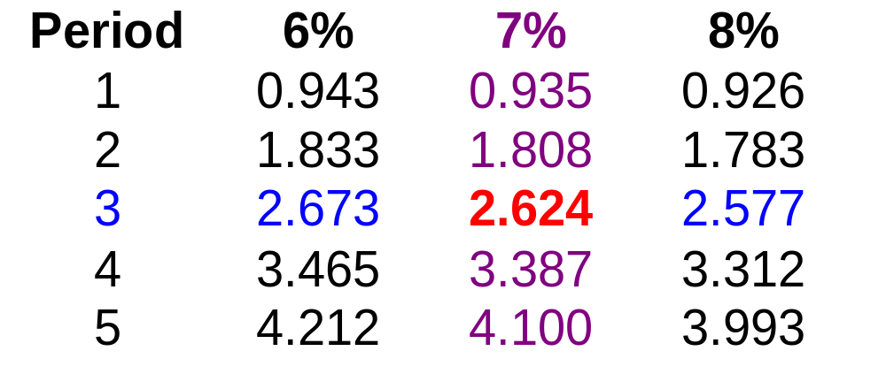
Valuation Using Table IV
PVA_{n} = R (PVIFA_{i%,n}) PVA₃ = $1,000 (PVIFA_{7%,3}) = $1,000 (2.624) = $2,624

Slide 44
Overview of an
Annuity Due -- PVAD
Cash flows occur at the beginning of the period
0 1 2 n-1 n
i%
. . .
R R R R
R: Periodic
Cash Flow
PVAD_{n}
PVAD_{n} = R/(1+i)⁰ + R/(1+i)¹ + ... + R/(1+i)^{n-1} = PVA_{n} (1+i)

Slide 45
Example of an
Annuity Due -- PVAD
Cash flows occur at the beginning of the period
0 1 2 3 4
7%
$1,000.00 $1,000 $1,000
$ 934.58
$ 873.44
$2,808.02 = PVAD_{n}
PVAD_{n} = $1,000/(1.07)⁰ + $1,000/(1.07)¹ + $1,000/(1.07)² = $2,808.02

Slide 46
Valuation Using Table IV
PVAD_{n} = R (PVIFA_{i%,n})(1+i)
PVAD₃ = $1,000 (PVIFA_{7%,3})(1.07) = $1,000 (2.624)(1.07) = $2,808

Slide 47
Steps to Solve Time Value of Money Problems
1. Read problem thoroughly
2. Determine if it is a PV or FV problem
3. Create a time line
4. Put cash flows and arrows on time line
5. Determine if solution involves a single CF, annuity stream(s), or mixed flow
6. Solve the problem
7. Check with financial calculator (optional)

Slide 48
Mixed Flows Example
Julie Miller will receive the set of cash flows below. What is the Present Value at a discount rate of 10%?
0 1 2 3 4 5
10%
$600 $600 $400 $400 $100
PV₀

Slide 49
How to Solve?
1. Solve a “piece-at-a-time” by discounting each piece back to t=0.
2. Solve a “group-at-a-time” by first breaking problem into groups of annuity streams and any single cash flow group. Then discount each group back to t=0.

Slide 50
“Piece-At-A-Time”
0 1 2 3 4 5
10%
$600 $600 $400 $400 $100
$545.45
$495.87
$300.53
$273.21
$ 62.09
$1677.15 = PV₀ of the Mixed Flow

Slide 51
“Group-At-A-Time” (#1)
0 1 2 3 4 5
10%
$600 $600 $400 $400 $100
$1,041.60
$ 573.57
$ 62.10
$1,677.27 = PV₀ of Mixed Flow [Using Tables]
$600(PVIFA_{10%,2}) = $600(1.736) = $1,041.60
$400(PVIFA_{10%,2})(PVIF_{10%,2}) = $400(1.736)(0.826) = $573.57
$100 (PVIF_{10%,5}) = $100 (0.621) = $62.10

Slide 52
“Group-At-A-Time” (#2)
0 1 2 3 4
$400 $400 $400 $400
$1,268.00
0 1 2
PV₀ equals
$1677.30.
Plus
$200 $200
$347.20
0 1 2 3 4 5
Plus
$100
$62.10

Slide 53
Frequency of Compounding
General Formula:
FV_{n} = PV₀(1 + [i/m])^{mn}
n: Number of Years m: Compounding Periods per Year i: Annual Interest Rate FV_{n,m}: FV at the end of Year n
PV₀: PV of the Cash Flow today

Slide 54
Impact of Frequency
Julie Miller has $1,000 to invest for 2 years at an annual interest rate of 12%.
Annual FV₂ = 1,000(1+ [.12/1])⁽¹⁾⁽²⁾ = 1,254.40
Semi FV₂ = 1,000(1+ [.12/2])⁽²⁾⁽²⁾ = 1,262.48

Slide 55
Impact of Frequency
Qrtly FV₂ = 1,000(1+ [.12/4])⁽⁴⁾⁽²⁾ = 1,266.77
Monthly FV₂ = 1,000(1+ [.12/12])⁽¹²⁾⁽²⁾ = 1,269.73
Daily FV₂ = 1,000(1+[.12/365])⁽³⁶⁵⁾⁽²⁾ = 1,271.20

Slide 56
Solving the Frequency Problem (Quarterly)
Inputs
2(4) 12/4 -1,000 0
N
I/Y
PV
PMT
FV
Compute
1266.77
The result indicates that a $1,000 investment that earns a 12% annual rate compounded quarterly for 2 years will earn a future value of $1,266.77.

Slide 57
Effective Annual
Interest Rate
Effective Annual Interest Rate
The actual rate of interest earned (paid) after adjusting the nominal rate for factors such as the number of compounding periods per year.
(1 + [ i / m ] )^{m} - 1

Slide 58
BW’s Effective
Annual Interest Rate
Basket Wonders (BW) has a $1,000 CD at the bank. The interest rate is 6% compounded quarterly for 1 year. What is the Effective Annual Interest Rate (EAR)?
EAR = ( 1 + 6% / 4 )⁴ - 1 = 1.0614 - 1 = .0614 or 6.14%!

Slide 59
Steps to Amortizing a Loan
1. Calculate the payment per period.
2. Determine the interest in Period t. (Loan balance at t-1) x (i% / m)
3. Compute principal payment in Period t. (Payment - interest from Step 2)
4. Determine ending balance in Period t. (Balance - principal payment from Step 3)
5. Start again at Step 2 and repeat.

Slide 60
Amortizing a Loan Example
Julie Miller is borrowing $10,000 at a compound annual interest rate of 12%. Amortize the loan if annual payments are made for 5 years.
Step 1: Payment
PV₀ = R (PVIFA _{i%,n})
$10,000 = R (PVIFA _{12%,5})
$10,000 = R (3.605)
R = $10,000 / 3.605 = $2,774

Slide 61
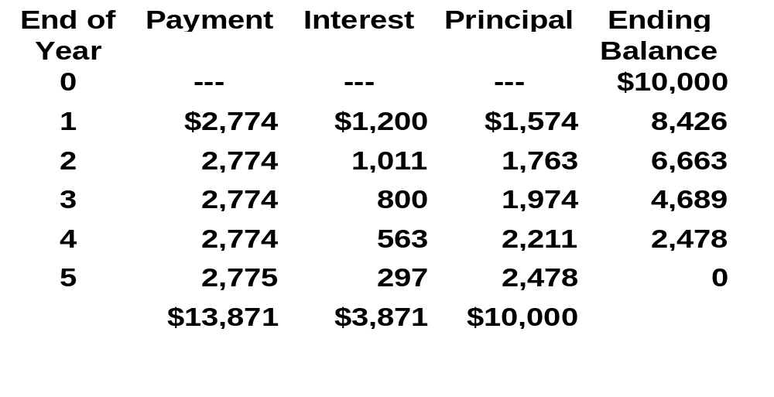
Amortizing a Loan Example
[Last Payment Slightly Higher Due to Rounding]

Slide 62
Usefulness of Amortization
1. Determine Interest Expense -- Interest expenses may reduce taxable income of the firm.
2. Calculate Debt Outstanding -- The quantity of outstanding debt may be used in financing the day-to-day activities of the firm.

